Slide 1
AirKitchen:
Week4 Update
Team FoodXYZ
Mengdan Yuan, Wen Xin

Slide 2


Slide 3
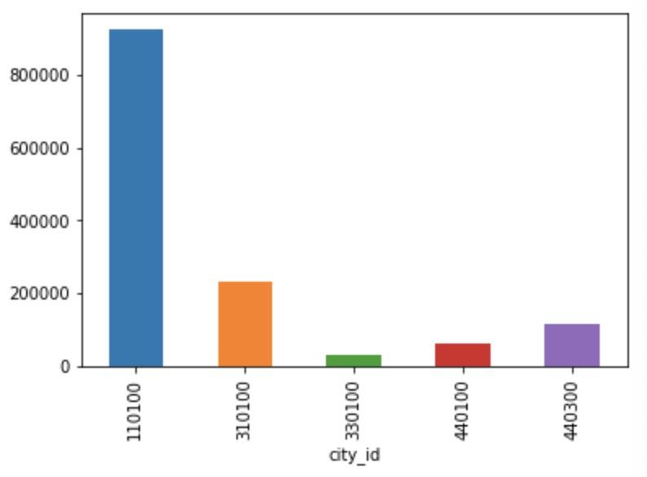
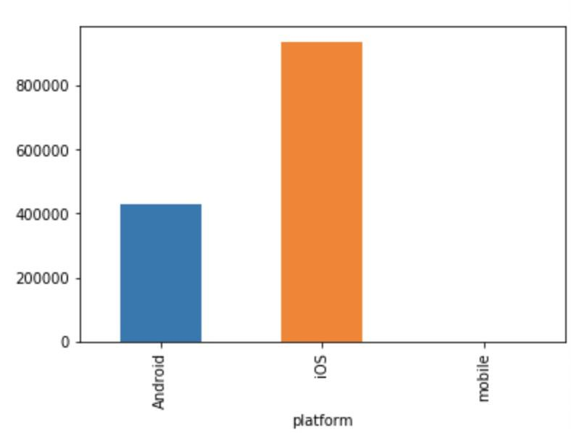
Order EDA
There are 1.37M order from April to June
95% orders using coupon
110100 this city has most orders
900K orders made by iOS, 400K made by Android
There are 212K active users from April to June
There are 5524 active kitchen from April to June

Slide 4
User info EDA
473628 users in total
Users live in 7 cities: 110000, 110100, 310100, 440100, 440300, 330100, 310000;
64.68% users come from 110100, 14.5% users come from 310100, 9% users come from 440300.
68.39% users use IOS and 31.42% users use Android

Slide 5
Next Step
Do some further EDA,
like combine coupon data and order data to find more insights
Within the timeframe of the transaction data we are given, what’s the percentage of users that place an order in the last month? Last week? Last two weeks?
Create training set and test set for the classification problem: predict whether a user will place an order in the next month.
Each row represents a user, which requires feature engineering to extract features from order data and coupon data
Identify the sample size in each category: is the data imbalanced? If it’s imbalanced how to solve this problem?
Notes:
Whether your customers are people or businesses, and no matter if you're selling products or services, the problem is still the same: Keeping current customers while continuing to grow with new ones. This means understanding who is no longer a buyer and why they've chosen to leave. Once you have the answers, you can work on your retention practices to prevent similar losses in the future.
If the prediction matches the actual status of the customer, then there is no action necessary. However, if an active customer is predicted to be a churned customer, this will imply that this customer is at-risk of churning. Alternatively, if a customer is currently inactive (meaning that they previously churned), but the prediction is that they are an active customer, this may indicate that they are a good target with which to attempt to reinstate business.

